Slide 1

Smart Education
Empowering Minds Everywhere

Slide 2
Team 2k29
Thanmayee Vempati
Itaraju Kavya Priya
P.Bhavya Sri
A.Ruthvika

Slide 3
Course Outline
Introduction
Problem Statement
Benefits
Solution
Conclusion

Slide 4
Introduction
Mission: Empowering learners through innovative online resources.
Vision: Revolutionizing education through accessible and engaging platforms.
It is an innovative online learning platform designed to provide engaging and effective educational resources to learners of all ages.
A diverse range of courses spanning various subjects and skill levels, It aims to empower individuals to pursue their learning goals at their own pace and convenience.
Through interactive lessons, quizzes, and multimedia content, learners can acquire new knowledge and skills in a fun and interactive way.
Introduction
Problem Statement
Solution
Conclusion

Slide 5
Problem Statement
Inadequate Access: Many regions and communities lack sufficient access to quality educational resources, including schools, teachers, and learning materials.
Quality of Education: Even where education is accessible, the quality may vary significantly, impacting students' ability to acquire essential skills and knowledge.
Financial Barriers: Economic constraints can prevent access to education, as families may struggle to afford school fees, uniforms, transportation, or other associated costs. This financial burden disproportionately affects marginalized communities and exacerbates educational disparities.
"Language and Cultural Barriers: Cultural and linguistic differences hinder effective learning, especially for marginalized groups. Inadequate adaptation of educational materials and methods limits inclusivity. Solutions entail culturally sensitive curriculum and language support initiatives for equitable education access."
Need for Innovation: There is a growing need for innovative solutions that leverage technology to address these challenges and improve educational access, quality, and outcomes for all learners.
Problem Statement
Introduction
Solution
Conclusion

Slide 6
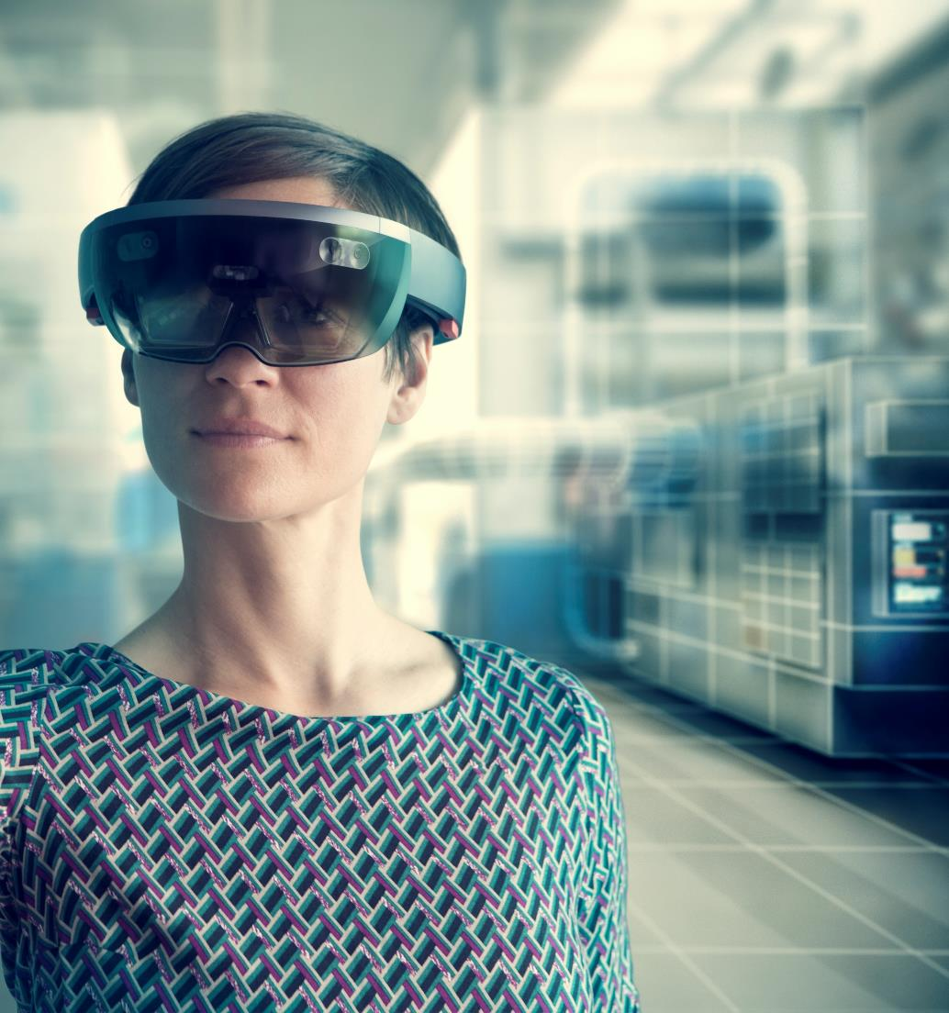
How is it useful for users?
Flexible Learning: Users can access courses at their own pace and convenience, fitting learning around their busy schedules.
Wide Range of Topics: With a diverse selection of courses spanning various subjects and skill levels, Learnify Me caters to a broad range of interests and learning goals.
Accessible Anywhere: As an online platform, Learnify Me can be accessed from anywhere with an internet connection, enabling learning on-the-go.
High-Quality Content: Courses on the platform are curated to ensure high-quality content, providing users with valuable knowledge and skills.
Interactive Learning: Many courses feature interactive elements such as quizzes, assignments, and multimedia content, making the learning experience engaging and enjoyable.
Professional Development: It offers courses that help individuals enhance their professional skills and advance their careers, making it a valuable resource for lifelong learning and career growth.
Introduction
Problem Statement
Solution
Conclusion

Slide 7
Solution
Technology Integration: Integrate technology into education to enhance accessibility and engagement. This includes providing online courses, educational apps, and digital resources that can reach students in remote areas.
Infrastructure Development: Invest in building and improving educational infrastructure, such as schools, libraries, and internet connectivity, especially in underserved communities.
Teacher Training: Provide comprehensive training for educators to equip them with modern teaching methods, digital literacy skills, and techniques for addressing diverse learning needs.
Curriculum Enhancement: Develop and update curricula to align with the needs of the 21st century, incorporating subjects like digital literacy, critical thinking, and problem-solving skills.
Community Engagement: Involve parents, community leaders, and local organizations in educational initiatives to create a supportive learning environment and foster collaboration between stakeholders.
Equity-Focused Policies: Implement policies and initiatives aimed at reducing educational disparities, such as scholarships for marginalized students, affirmative action programs, and targeted interventions in low-performing schools.
Solution
Introduction
Problem Statement
Conclusion

Slide 8
Summary
It is an innovative online learning platform with a mission to democratize education and empower individuals worldwide to pursue their learning goals.
By offering a wide range of high-quality courses, flexible learning options, and interactive content, It provides users with a valuable and accessible learning experience.
Whether users are seeking to develop new skills, explore new interests, or advance their careers, It offers a platform for lifelong learning and personal growth.
With its commitment to accessibility, quality, diversity, and innovation, It stands as a valuable resource for individuals looking to unlock their full potential through education.
Conclusion
Introduction
Problem Statement
Solution

